Slide 2

THE STATUS OF INNOVATION AND TECHNOLOGY OF VIETNAMESE FIRMS & ITS IMPACT TO FIRMS PERFORMANCE
GROUP 4
Tống Ngọc Huyền – 20213065
Nguyễn Ngọc Vân Khanh – 20213066
Nguyễn Đỗ Quyên – 20213093
Bùi Ánh Vân – 20213106

Slide 3
TABLE OF CONTENT
A. Data Visualization: Describe the status of Innovation and Technology of Vietnamese firms
B. Regression Model: Estimate the impact of Innovation and Technology to Firms performance

Slide 4
A. DATA VISUALIZATION

Slide 5
VARIABLES DEFINITION
b8
Firms with internationally-recognized quality certification
a0
Business Sector
Manufacturing, Retail Services, Other Services
e6
Firms using technology licensed from foreign companies
c22b
Firms having its own website
I1
Firm Size
Composite measure of permanent and temporary workers
h1
Firms introducing new products/ services
h2
Firms improving products/ services
h5
Firms introducing process innovation
b5
Age (years)
Age the firm based on the year in which the firm began operations
h8
Firms spending on R&D

Slide 6
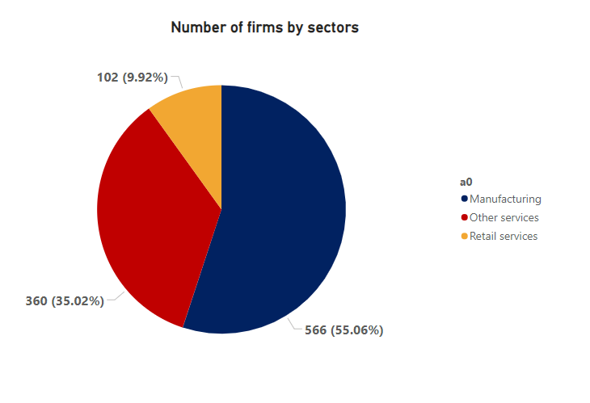
I. CHARACTERISTICS OF VIETNAMESE FIRMS SURVEYED
1. Business Sectors
Manufacturing
55%
Other Services
35%
Retail Services
10%

Slide 7
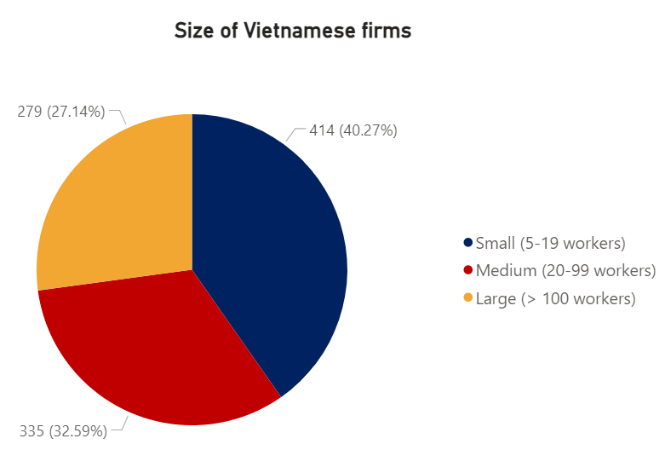
I. CHARACTERISTICS OF VIETNAMESE FIRMS SURVEYED
2. Firm Size
Small (5-19 workers)
40%
Medium (20-99 workers)
33%
Large (>100 workers)
27%

Slide 8
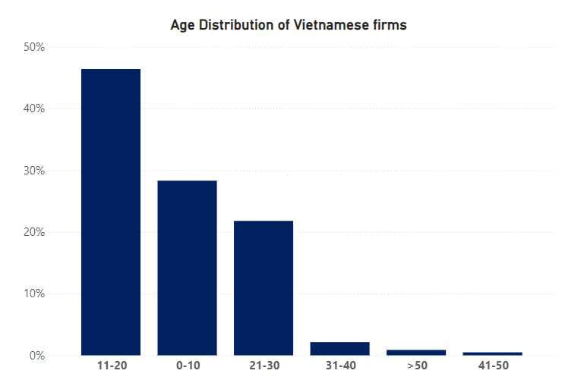
I. CHARACTERISTICS OF VIETNAMESE FIRMS SURVEYED
3. Firm Age
11-20 years firms
46%
Start-up firms
28%
Vietnam is in a phase of promoting innovation and creativity in companies across various sectors

Slide 9
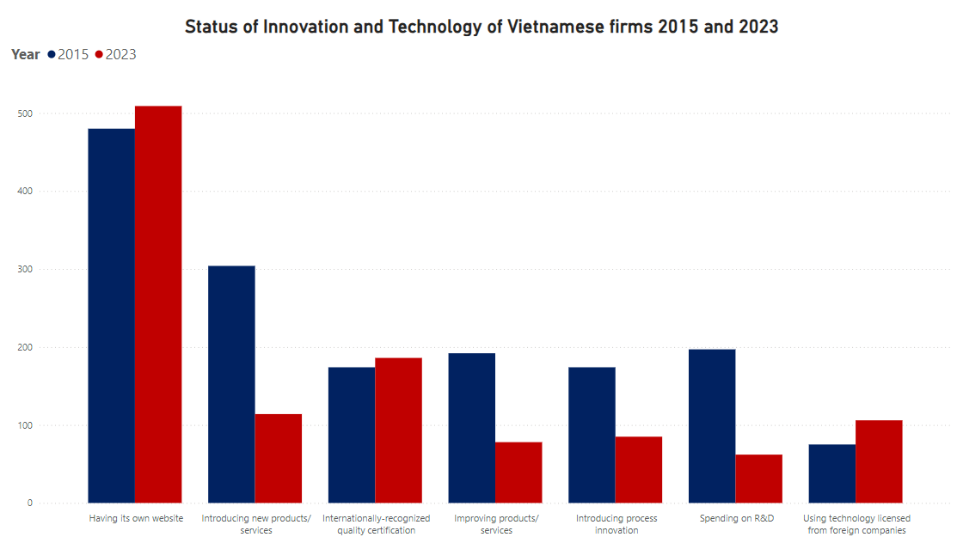
II. OVERVIEW THE STATUS OF I&T OF VIETNAMESE FIRMS
1. Status of Innovation & Technology of Vietnamese firms 2015 and 2023
Having its own websites
Continuously growing
Good sign for promoting the use of e-commerce, which has broughht a breakthrough in technology in Vietnam
Using foreign technology licensed
Strongly growing from 75 to 106
Focusing on technology development
Significant decreased compared to 2015
The number of companies introducing new products/ services that decresed nearly one-third
The number of companies spending on R&D decreased 50%

Slide 10
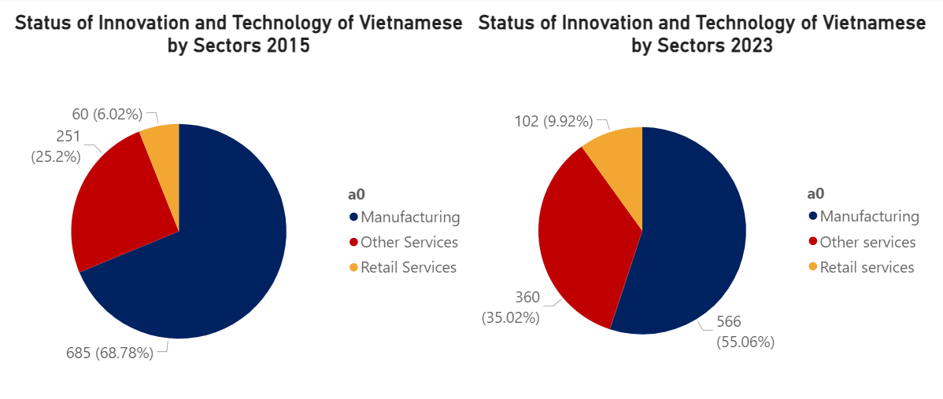
2. Status of Innovation & Technology of Vietnamese Sectors 2015 and 2023
II. OVERVIEW THE STATUS OF I&T OF VIETNAMESE FIRMS
Companies in the manufacturing sector continued to maintain a high percentage of the use of technology and innovation in the production process. However, by 2023, retail and other service industries are increasingly adopting technology and innovation.
Notes:
Ứng dụng chuyển đổi số và sáng tạo mạnh mẽ
Các yếu tố
Ngành sản xuất đang ứng dụng công nghệ và thực hiện chuyển đổi số cao hơn so với các ngành khác

Slide 11
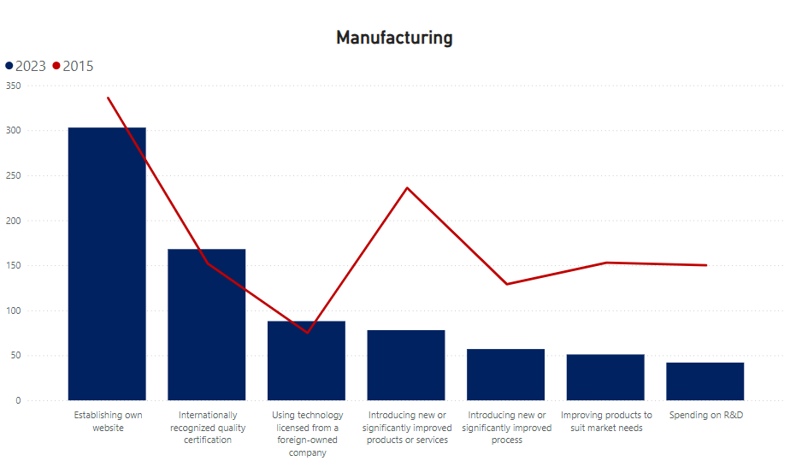
2. Status of Innovation & Technology of Vietnamese Sectors 2015 and 2023
II. OVERVIEW THE STATUS OF I&T OF VIETNAMESE FIRMS
In 2023, the number of companies in the manufacturing sector investing in developing new products, new processes, and R&D has decreased significantly compared to 2015

Slide 12
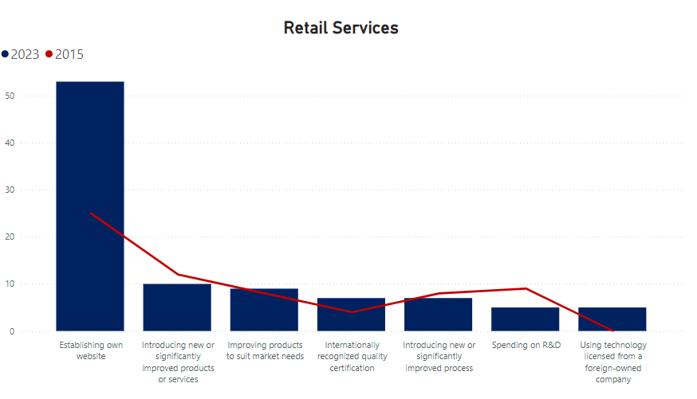
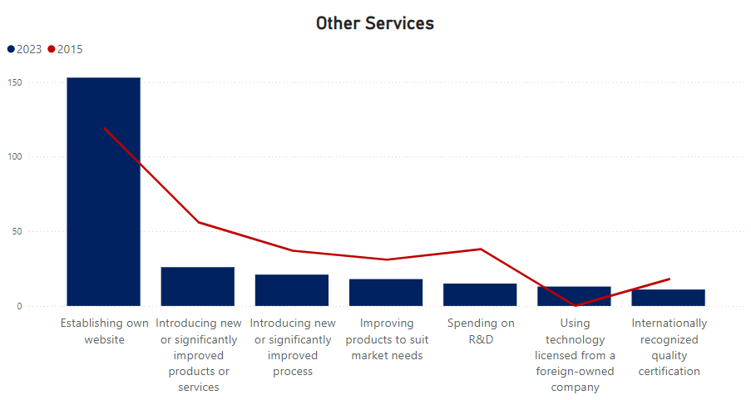
2. Status of Innovation & Technology of Vietnamese Sectors 2015 and 2023
II. OVERVIEW THE STATUS OF I&T OF VIETNAMESE FIRMS
Companies in the retail and other service sectors are gradually undergoing a strong digital transformation, establishing their own websites and acquiring technology licenses from foreign companies since 2023

Slide 13
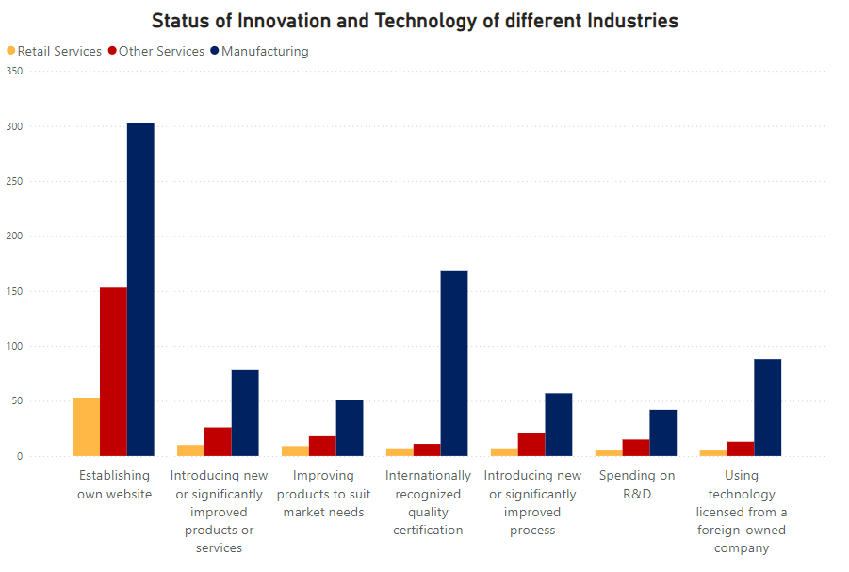
3. Status of Innovation and Technology of Vietnamese Firms 2023
II. OVERVIEW THE STATUS OF I&T OF VIETNAMESE FIRMS
Manufacturing, retail services, and other services sectors
Focusing on intensifying the establishment of their own websites
Manufacturing sector
The manufacturing sector is applying technology and innovation factors at a higher level of digital transformation compared to other sectors

Slide 14
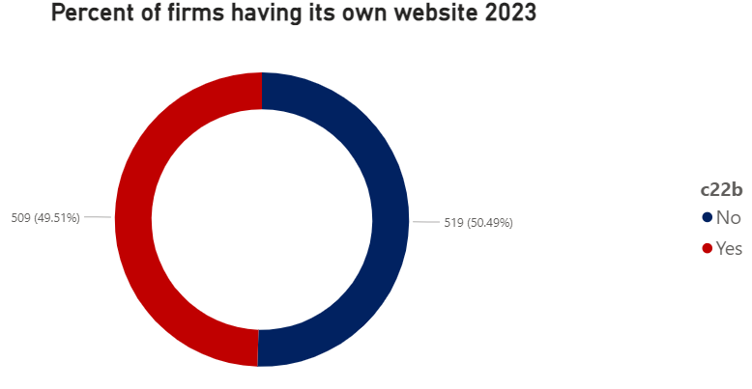
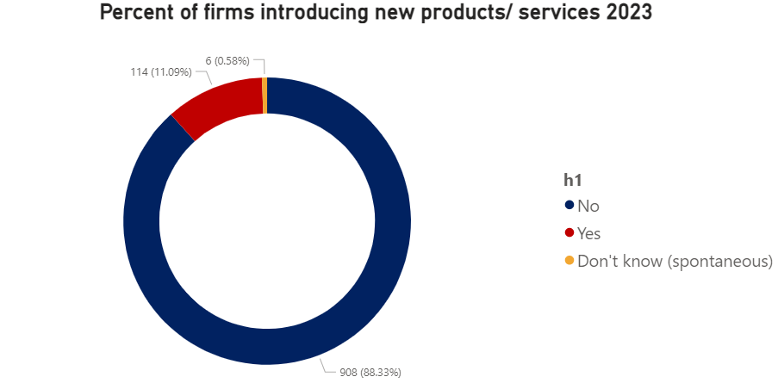
II. OVERVIEW THE STATUS OF I&T OF VIETNAMESE FIRMS
3. Status of Innovation and Technology of Vietnamese Firms 2023
Approximately 50% of the surveyed companies have their own website.. However, nearly 90% of companies are not launching new products or services in 2023
Notes:
Nearly 50% of the surveyed companies have their own website.. However, nearly 90% of companies are not launching new products or services in 2023

Slide 15
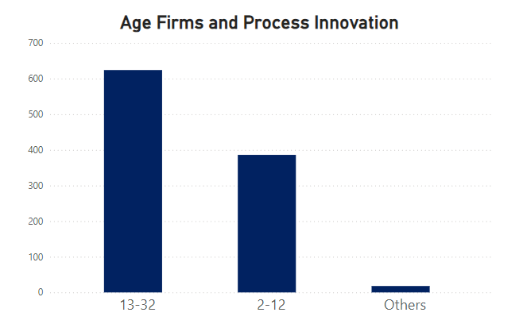
3. Status of Innovation and Technology of Vietnamese Firms 2023
II. OVERVIEW THE STATUS OF I&T OF VIETNAMESE FIRMS
Age Firms and Process Innovation
There are over 600 companies with an operating time ranging from 13 to 32 years that are implementing process innovation, which is nearly double the number of companies with an operating time of 2 to 12
The longer-established companies need to carry out service and product innovation processes in order to meet market demands and gain market share

Slide 16
B. REGRESSION MODEL

Slide 17
I. TARGET
Estimate the impact of Innovation and Technology to Firms performance in 2023
Identify which factors of Innovation and Technology have the most influence on the total annual sales of the company
→ The enterprise can implement suitable strategies related to Innovation and Technology to improve the annual sales
Notes:
By using data collected by Vietnamese Enterprise Surveys, we conduct regression model to estimate the impact of Innovation and Technology to Firms performance in 2023. Moreover, through this model, individuals can identify which factors of Innovation and Technology have the most influence on the total annual sales of the company. From that, the enterprise can implement suitable strategies related to Innovation and Technology to improve the annual sales.

Slide 18
II. VARIABLES DEFINITION
Dependent Variable
d2_log: logarithm of total annual sales of firms in 2023
Independent Variables
b8, e6, c22b, h1, h5, h8, a6a: see variables definition in Part A
f1: the capacity ultilzation (%) of this establishment in last FY
c36: whether establishment apply to obtain fixed broadband internet connection over the last 2 years (1: Yes, 2: No)
c39: is there any internet disruptions in last FY (1: Yes, 2: No)
l4b: number of permanent, full-time low skilled production worker
l1: number of permanent, full-time employees at end of last FY
a2: sampling region (1: Northern Central region, the Central Coast, Central Highlands; 2: Red River Delta; 3: Northern Midlands and Mountains; 4: Southeast; 5: Mekong River Delta)
Notes:
Dependent variable:
d2_log: logarithm of total annual sales of firms in 2023
Independent variables:
b8: whether the enterprise have an internationally-recognized quality certification or not (1: Yes, 2: No)
e6: whether the enterprise use technology from a foreign-owned company or not (1: Yes, 2: No)
c22b: whether the establishment has its own website or not (1: Yes, 2: No)
h1: are there any new products/services introduced over last 3 years (1: Yes, 2: No)
f1: the capacity ultilzation (%) of this establishment in last FY
h5: whether the establishment introduced new/significantly improved process during las 3 years (1: Yes, 2: No)
h8: during the last fiscal year, establishment spent on R&D or not (1: Yes, 2: No)
c36: whether establishment apply to obtain fixed broadband internet connection over the last 2 years (1: Yes, 2: No)
c39: is there any internet disruptions in last FY (1: Yes, 2: No)
l4b: number of permanent, full-time low skilled production worker
l1: number of permanent, full-time employees at end of last FY
a6a: sampling size - 3 categories: Small (5 to 19 employees), Medium (20 to 99 employees), Large (100 or more employees).
a2: sampling region (1: Northern Central region, the Central Coast, Central Highlands; 2: Red River Delta; 3: Northern Midlands and Mountains; 4: Southeast; 5: Mekong River Delta)

Slide 19
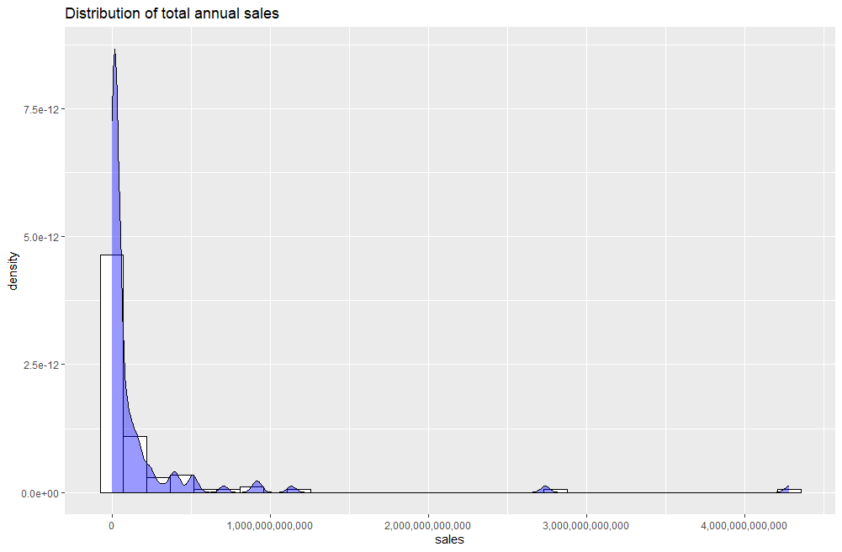
III. RELATIONSHIPS DESCRIPTION
The distribution of the total annual sales is highly skewed to the right
The total annual sales are mainly below 500,000B VND
Some very large outliers located far to the right
Most revenue values ​​are concentrated in small values
Notes:
Appendix III.1: Distribution of total annual sales
The histogram shows that the distribution of the total annual sales of firms in 2023 is highly skewed to the right. Most revenue values ​​are concentrated in small values, while there are some very large revenue values ​​(outliers) located far to the right, which are not too common. Additionally, the total annual sales of Vietnames enterprises are mainly below 500,000B VND

Slide 20
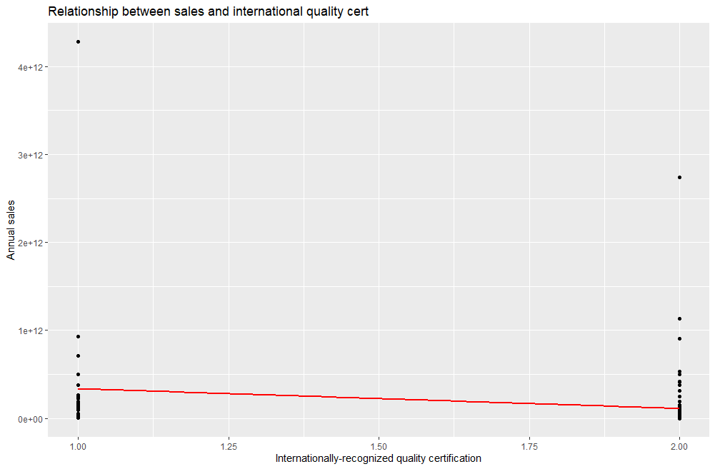
III. RELATIONSHIPS DESCRIPTION
Positive relationship between the ownership of internationally-recognized quality certifications and total annual sales
(1: Yes; 2: No)
The international-recognized quality certifications play a crucial role in enhancing the trust of customers
→ Contributing to the revenue growth
Notes:
Appendix III.2: Relationship between sales and international-recognized quality certifications
Chart III.2 shows that there is a positive relationship between the ownership of internationally-recognized quality certifications and total annual sales. If the establishments have an internationally-recognized quality certifications, the total annual revenue is higher than the firms that do not have this kind of certification.
Therefore, the international-recognized quality certifications play a crucial role in enhancing the trust of customers about the products/services provided, thus contributing to the revenue growth of companies.

Slide 21
III. RELATIONSHIPS DESCRIPTION
Positive relationship between the ownership of internationally-recognized quality certifications and total annual sales
The international-recognized quality certifications play a crucial role in enhancing the trust of customers
→ Contributing to the revenue growth
(1: Yes; 2: No)
Notes:
Appendix III.2: Relationship between sales and international-recognized quality certifications
Chart III.2 shows that there is a positive relationship between the ownership of internationally-recognized quality certifications and total annual sales. If the establishments have an internationally-recognized quality certifications, the total annual revenue is higher than the firms that do not have this kind of certification.
Therefore, the international-recognized quality certifications play a crucial role in enhancing the trust of customers about the products/services provided, thus contributing to the revenue growth of companies.

Slide 22
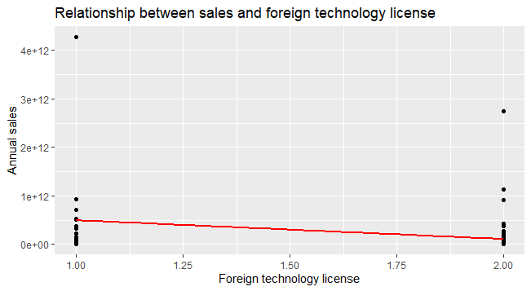
III. RELATIONSHIPS DESCRIPTION
Significant positive relationship between Using technology from a foreign-owned company and the total annual revenue
(1: Yes; 2: No)
Foreign-owned companies often provide cutting-edge technology that can significantly enhance productivity, efficiency, and innovation → Companies can improve their operational capabilities and product offerings, leading to higher sales
Notes:
Appendix III.3: Relationship between sales and foreign technology license
Using technology from a foreign-owned company shows a significant positive trend with the total annual revenue of companies. The establishments use technology from a foreign-owned compant, the total annual sales also increase.
Foreign-owned companies often provide cutting-edge technology that can significantly enhance productivity, efficiency, and innovation within an enterprise. By leveraging these advanced tools and solutions, companies can improve their operational capabilities and product offerings, leading to higher sales

Slide 23
III. RELATIONSHIPS DESCRIPTION
Significant positive relationship between sales and the use of technology from a foreign-owned company
Foreign-owned companies often provide cutting-edge technology that can significantly enhance productivity, efficiency, and innovation → Companies can improve their operational capabilities and product offerings, leading to higher sales
(1: Yes; 2: No)
Notes:
Appendix III.3: Relationship between sales and foreign technology license
Using technology from a foreign-owned company shows a significant positive trend with the total annual revenue of companies. The establishments use technology from a foreign-owned compant, the total annual sales also increase.
Foreign-owned companies often provide cutting-edge technology that can significantly enhance productivity, efficiency, and innovation within an enterprise. By leveraging these advanced tools and solutions, companies can improve their operational capabilities and product offerings, leading to higher sales

Slide 24
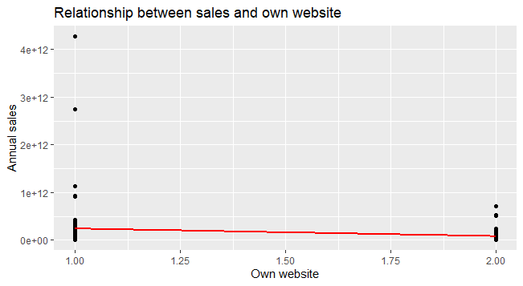
III. RELATIONSHIPS DESCRIPTION
Positive relationship between sales and the ownership website of establishments
(1: Yes; 2: No)
Notes:
Appendix III.4: Relationship between sales and own website
There seems to be a positive relationship between sales and the ownership website of establishments. If a company has its own website, this can help the business enhance customer experience, leading the sales growth

Slide 25
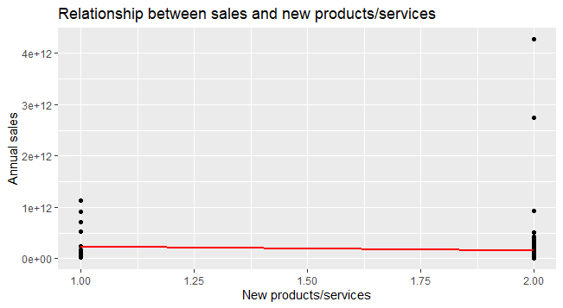
III. RELATIONSHIPS DESCRIPTION
Slightly positive relationship between sales and the introduction of new products/services
(1: Yes; 2: No)
Notes:
Appendix III.5: Relationship between sales and new products/services
The introduction of new products/services has a slightly positive trend with total annual sales. Whether companies launch new products/services or not does not have a significant impact on the total annual sales of businesses
Besides, several establishments which do not have new products/services introduced over the last 3 years generate higher total annual sales than the enterprises which introduce new products/services

Slide 26
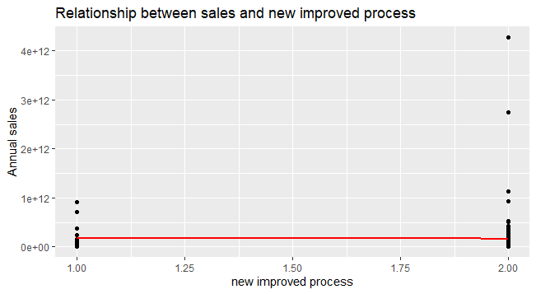
III. RELATIONSHIPS DESCRIPTION
Weak relationship between sales and the new/significantly improved process introduced
(1: Yes; 2: No)
Notes:
Appendix III.6: Relationship between sales and new improved process
There is a weak relationship between sales and the new/significantly improved process introduced during the last 3 years. The new/significantly improved process does not affect the revenue earned by establishments

Slide 27
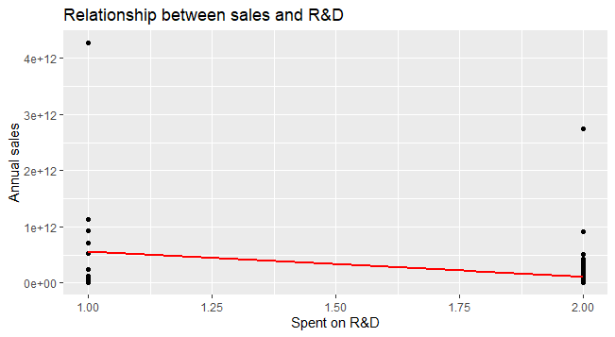
III. RELATIONSHIPS DESCRIPTION
Positive relationship between sales and R&D investment
Notes:
Appendix III.7: Relationship between sales and R&D
The relationship between sales and investment in R&D shows a positive trend. Companies which spend on R&D activities can improve the products/services to adapt the demand of customers. Hence, the enterprises’ sales tend to rise.

Slide 28
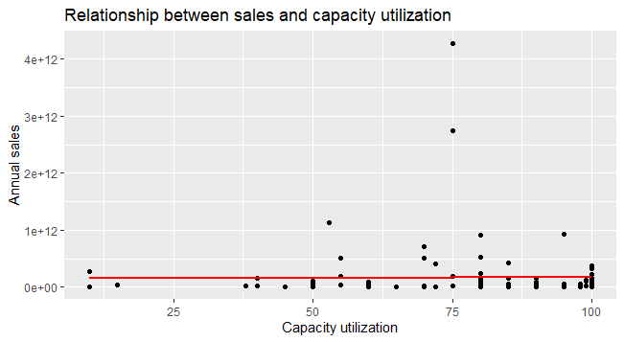
III. RELATIONSHIPS DESCRIPTION
No significant impact of capacity utilization on annual sales
Notes:
Appendix III.8: Relationship between sales and capacity utilization
It illustrates that capacity utilization does not significantly impact the total annual sales of companies. However, when capacity utilization increases, the total annual revenue of businesses improves. With capacity utilization is 75%, there are companies earning the highest sales.

Slide 29
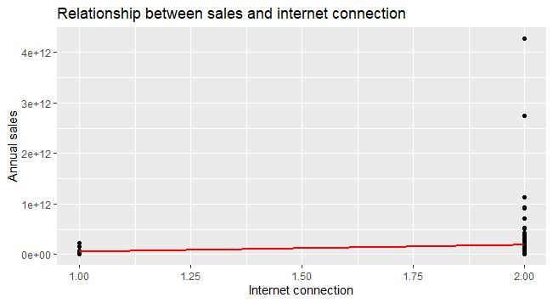
III. RELATIONSHIPS DESCRIPTION
Negative relationship between sales and using fixed broadband Internet connection
→ Customers tend to shift away from fixed broadband services
(1: Yes; 2: No)
Notes:
Appendix III.9: Relationship between sales and fixed broadband Internet connection
There is a negative relationship between sales and using fixed broadband Internet connection. Establishments invest in fixed broadband Internet connection, but the total annual sales do not rise. This phenomenon may be due to the increasing use of mobile broadband. With the development of mobile and flexible internet connections, customers tend to shift away from fixed broadband services

Slide 30
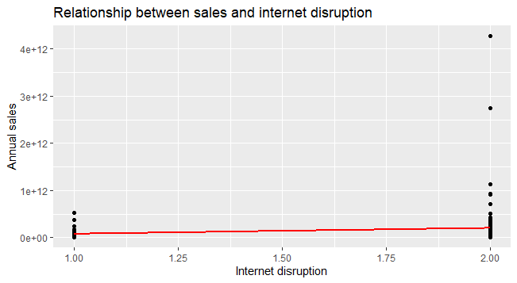
III. RELATIONSHIPS DESCRIPTION
Negative relationship between sales and Internet disruptions
→ Companies should reduce the likelihood to take place Internet disruptions
(1: Yes; 2: No)
Notes:
Appendix III.10: Relationship between sales and Internet disruptions
Total annual sales have a negative trend with Internet disruptions. If establishments take place of Internet disruptions, the total annual sales are likely to decrease. Therefore, Vietnamese companies should reduce the likelihood to take place Internet disruptions to increase the customer experence.

Slide 31
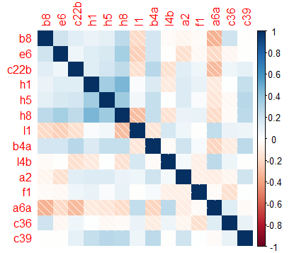
III. RELATIONSHIPS DESCRIPTION
The correlation coefficients are low (below 0.7)
→ No multicollinearity phenomenon
Notes:
Appendix III.11: Correlation matrix
The correlation coefficients are low (below 0.7)
→ There is no multicollinearity phenomenon between independent variables.

Slide 32
IV. REGRESSION MODEL: FULL MODEL
 | Estimate | Std.Error | T value | P value
(Intercept) | 24.439394 | 1.4994922 | 16.298 | <2e-16
b8 | -0.8789934 | 0.3251435 | -2.703 | 0.008030
e6 | -0.7893195 | 0.3623397 | -2.178 | 0.031657
c22b | -0.185669 | 0.2587461 | -0.178 | 0.474645
h1 | -1.1048736 | 0.3735220 | -2.958 | 0.003841
l4b | 0.0030686 | 0.0011860 | 2.587 | 0.011070
l1 | 0.0006254 | 0.0001990 | 3.143 | 0.002186
h8 | 0.4572062 | 0.4690647 | 0.975 | 0.331983
a6a | 0.6804501 | 0.1996768 | 3.408 | 0.000936
f1 | 0.0133116 | 0.0055266 | 2.409 | 0.017789
h5 | 0.0305266 | 0.3804878 | 0.080 | 0.936210
a2 | 0.1358977 | 0.10236710 | 1.324 | 0.188559
a4a | -0.0653203 | 0.1002593 | -0.652 | 0.516166
c36 | 0.6294876 | 0.3552179 | 1.772 | 0.079332
c39 | 0.0862656 | 0.2830849 | 0.305 | 0.761184

Slide 33
IV. REGRESSION MODEL: FULL MODEL
 | Estimate | Std.Error | T value | P value
(Intercept) | 24.439394 | 1.4994922 | 16.298 | <2e-16
b8 | -0.8789934 | 0.3251435 | -2.703 | 0.008030
e6 | -0.7893195 | 0.3623397 | -2.178 | 0.031657
c22b | -0.185669 | 0.2587461 | -0.178 | 0.474645
h1 | -1.1048736 | 0.3735220 | -2.958 | 0.003841
l4b | 0.0030686 | 0.0011860 | 2.587 | 0.011070
l1 | 0.0006254 | 0.0001990 | 3.143 | 0.002186
h8 | 0.4572062 | 0.4690647 | 0.975 | 0.331983
a6a | 0.6804501 | 0.1996768 | 3.408 | 0.000936
f1 | 0.0133116 | 0.0055266 | 2.409 | 0.017789
h5 | 0.0305266 | 0.3804878 | 0.080 | 0.936210
a2 | 0.1358977 | 0.10236710 | 1.324 | 0.188559
a4a | -0.0653203 | 0.1002593 | -0.652 | 0.516166
c36 | 0.6294876 | 0.3552179 | 1.772 | 0.079332
c39 | 0.0862656 | 0.2830849 | 0.305 | 0.761184
P-value <0.05
95% of confidence interval
|t-value| > 1.96
→ b8, e6, h1, l4b, l1, a6a, f1 have effect on the d2
Adjusted R-squared: 49.02%
Multiple R-squared: 55.12%.

Slide 34
IV. REGRESSION MODEL: SHORTENED MODEL
 | Estimate | Std.Error | T value | P value
(Intercept) | 24.7389161 | 1.3279532 | 18.629 | <2e-16
b8 | -0.9526742 | 0.3141190 | -3.033 | 0.003046
e6 | -0.8723025 | 0.3509467 | -2.486 | 0.014497
c22b | -0.1693801 | 0.2530494 | -0.669 | 0.504724
h1 | -1.0296254 | 0.3632275 | -2.835 | 0.005494
l4b | 0.0032275 | 0.0011709 | 2.756 | 0.006882
l1 | 0.0006342 | 0.0001954 | 3.246 | 0.001566
h8 | 0.5393301 | 0.4571779 | 1.180 | 0.240763
a6a | 0.6850893 | 0.1899830 | 3.606 | 0.000476
f1 | 0.0124669 | 0.0054464 | 2.289 | 0.024059
c36 | 0.6214416 | 0.3475068 | 1.788 | 0.076587
c39 | 0.1191799 | 0.2720187 | 0.438 | 0.662183
Adjusted R-squared: 49.43%
Multiple R-squared: 54.19%

Slide 35
IV. REGRESSION MODEL: SHORTENED MODEL
Model:
d2_log = 24.739- 0.953* b8 - 0.872* e6 - 0.169* c22b – 1.03* h1 + 0.003* l4b + 0.0006* l1 + 0.539* h8 + 0.685* a6a + 0.012* f1 + 0.62* c36 + 0.119*c39

Slide 36
IV. REGRESSION MODEL: TESTING ASSUMPTIONS
1
Normal Distribution
H0: Residuals follow normal distribution.
H1: Residuals do not follow normal distribution.
Testing Result:
P-value = 0.0847 > 0.05
Not enough evidence to reject H0
Residuals follow normal distribution
Condition satisfied
Notes:
Normal distribution
H0: Residuals follow normal distribution.
H1: Residuals do not follow normal distribution.
P-value = 0.0847 >0.05 → Not enough evidence to reject H0. Therefore, residuals follow normal distribution.
Assumption 1
H0: mean(res) = 0
H1: mean(res) ≠ 0
P-value = 1 > 0.05 → Not enough evidence to reject H0. Therefore, mean(residuals) = 0 → Assumption 1 satisfies.
2. Assumption 2
H0: Variance of residuals is constant.
H1: Variance of residuals is non-constant.
P-value = 0.7696 > 0.05 → Not enough evidence to reject H0. Therefore, variance of residuals is constant → Assumption 2 satisfies.
Assumption 3
H0: There is no autocorrelation in residuals.
H1: There is autocorrelation in residuals.
P-value = 0.396 > 0.05 → Not enough evidence to reject H0. Therefore, there is no autocorrelation in residuals → Assumption 3 satisfies.

Slide 37
IV. REGRESSION MODEL: TESTING ASSUMPTIONS
2
Assumption 1
H0: Mean (Residuals) = 0
H1: Mean (Residuals) ≠ 0
Testing Result:
P-value = 0.0847 > 0.05
Not enough evidence to reject H0
Residuals follow normal distribution
Assumption 1 satisfied
Notes:
Assumption 1
H0: mean(res) = 0
H1: mean(res) ≠ 0
P-value = 1 > 0.05 → Not enough evidence to reject H0. Therefore, mean(residuals) = 0 → Assumption 1 satisfies.

Slide 38
IV. REGRESSION MODEL: TESTING ASSUMPTIONS
3
Assumption 2
H0: Variance of residuals is constant
H1: Variance of residuals is non-constant
Testing Result:
P-value = 0.7696 > 0.05
Not enough evidence to reject H0
Variance of residuals is constant
Assumption 2 satisfied
Notes:
2. Assumption 2
H0: Variance of residuals is constant.
H1: Variance of residuals is non-constant.
P-value = 0.7696 > 0.05 → Not enough evidence to reject H0. Therefore, variance of residuals is constant → Assumption 2 satisfies.

Slide 39
IV. REGRESSION MODEL: TESTING ASSUMPTIONS
3
Assumption 3
H0: There is no autocorrelation in residuals
H1: There is autocorrelation in residuals
Testing Result:
P-value = 0.396 > 0.05
Not enough evidence to reject H0
There is no autocorrelation in residuals
Assumption 3 satisfied
Notes:
Assumption 3
H0: There is no autocorrelation in residuals.
H1: There is autocorrelation in residuals.
P-value = 0.396 > 0.05 → Not enough evidence to reject H0. Therefore, there is no autocorrelation in residuals → Assumption 3 satisfies.

Slide 40
IV. REGRESSION MODEL: USING AIC METHOD
 | Estimate | Std.Error | T value | P value
(Intercept) | 24.9580670 | 1.2436537 | 20.068 | <2e-16
b8 | -0.8826530 | 0.3061677 | -2.883 | 0.00475
e6 | -0.7737608 | 0.3386661 | -2.285 | 0.02426
h1 | -0.8144581 | 0.3209901 | -2.537 | 0.01258
l4b | 0.0031734 | 0.0011598 | 2.736 | 0.00726
l1 | 0.0005907 | 0.0001861 | 3.174 | 0.00196
a6a | 0.7247379 | 0.1816837 | 3.989 | 0.00012
f1 | 0.0127067 | 0.0054026 | 2.352 | 0.02047
c36 | 0.5960082 | 0.3408986 | 1.748 | 0.08322

Slide 41
IV. REGRESSION MODEL: USING AIC METHOD
Model:
d2_log = 24.958 - 0.882* b8 - 0.773* e6 - 0.814* h1 + 0.003* l4b
+ 0.0005* l1 + 0.724* a6a + 0.012* f1 + 0.596* c36
Adjusted R-squared: 49.43%; Multiple R-squared: 54.19%
→ About 49.84% of the variation of the dependent variable is explained by the independent variables in the regression model
Notes:
Adjusted R-squared: 49.84%, Multiple R-squared: 53.27%.
→ About 49.84% of the variation of the dependent variable is explained by the independent variables in the regression model.

Slide 42
IV. REGRESSION MODEL: USING AIC METHOD
If establishments have an intertionally-recognized quality certifications, the logarithm of total annual sales increases by 0.882
Model:
d2_log = 24.958 - 0.882* b8 - 0.773* e6 - 0.814* h1 + 0.003* l4b
+ 0.0005* l1 + 0.724* a6a + 0.012* f1 + 0.596* c36
Adjusted R-squared: 49.43%; Multiple R-squared: 54.19%
→ About 49.84% of the variation of the dependent variable is explained by the independent variables in the regression model
Notes:
-0.882: if establishments have an intertionally-recognized quality certifications, the logarithm of total annual sales increases by 0.882.

Slide 43
IV. REGRESSION MODEL: USING AIC METHOD
If companies use technology licensed from a foreign-owned company, the logarithm of total annual sales increases by 0.773
Model:
d2_log = 24.958 - 0.882* b8 - 0.773* e6 - 0.814* h1 + 0.003* l4b
+ 0.0005* l1 + 0.724* a6a + 0.012* f1 + 0.596* c36
Adjusted R-squared: 49.43%; Multiple R-squared: 54.19%
→ About 49.84% of the variation of the dependent variable is explained by the independent variables in the regression model
Notes:
-0.773: if companies use technology licensed from a foreign-owned company, the logarithm of total annual sales increases by 0.773.

Slide 44
IV. REGRESSION MODEL: USING AIC METHOD
If establishments introduce new products/services over last 3 years, there will be a rise by 0.841 in the logarithm total annua sales
Model:
d2_log = 24.958 - 0.882* b8 - 0.773* e6 - 0.814* h1 + 0.003* l4b
+ 0.0005* l1 + 0.724* a6a + 0.012* f1 + 0.596* c36
Adjusted R-squared: 49.43%; Multiple R-squared: 54.19%
→ About 49.84% of the variation of the dependent variable is explained by the independent variables in the regression model
Notes:
-0.814: if establishments introduce new products/services over last 3 years, there will be a rise by 0.841 in the logarithm total annua sales.

Slide 45
IV. REGRESSION MODEL: USING AIC METHOD
An increase by a person in the number of permanent, full-time low-skilled production workers, the logarithm of total annual sales rises by 0.003
Model:
d2_log = 24.958 - 0.882* b8 - 0.773* e6 - 0.814* h1 + 0.003* l4b
+ 0.0005* l1 + 0.724* a6a + 0.012* f1 + 0.596* c36
Adjusted R-squared: 49.43%; Multiple R-squared: 54.19%
→ About 49.84% of the variation of the dependent variable is explained by the independent variables in the regression model
Notes:
0.003: an increase by a person in the number of permanent, full-time low-skilled production workers, the logarithm of total annual sales rises by 0.003.

Slide 46
IV. REGRESSION MODEL: USING AIC METHOD
Model:
d2_log = 24.958 - 0.882* b8 - 0.773* e6 - 0.814* h1 + 0.003* l4b
+ 0.0005* l1 + 0.724* a6a + 0.012* f1 + 0.596* c36
If the number of permanent, full-time employees at end of last FY increases by 1 person, the logarithm of total annual sales rises by 0.0005
Adjusted R-squared: 49.43%; Multiple R-squared: 54.19%
→ About 49.84% of the variation of the dependent variable is explained by the independent variables in the regression model
Notes:
0.005: if the number of permanent, full-time employees at end of last FY increases by 1 person, the logarithm of total annual sales rises by 0.0005.

Slide 47
IV. REGRESSION MODEL: USING AIC METHOD
Model:
d2_log = 24.958 - 0.882* b8 - 0.773* e6 - 0.814* h1 + 0.003* l4b
+ 0.0005* l1 + 0.724* a6a + 0.012* f1 + 0.596* c36
The larger the companies are, the higher revenue earned by the companies
Adjusted R-squared: 49.43%; Multiple R-squared: 54.19%
→ About 49.84% of the variation of the dependent variable is explained by the independent variables in the regression model
Notes:
0.724: the larger the companies are, the higher revenue earned by the companies.

Slide 48
IV. REGRESSION MODEL: USING AIC METHOD
Model:
d2_log = 24.958 - 0.882* b8 - 0.773* e6 - 0.814* h1 + 0.003* l4b
+ 0.0005* l1 + 0.724* a6a + 0.012* f1 + 0.596* c36
If establishments increase the capacity ultilization by 1%, the logarithm of total annual revenue increases by 0.012
Adjusted R-squared: 49.43%; Multiple R-squared: 54.19%
→ About 49.84% of the variation of the dependent variable is explained by the independent variables in the regression model
Notes:
0.012: if establishments increase the capacity ultilization by 1%, the logarithm of total annual revenue increases by 0.012.

Slide 49
IV. REGRESSION MODEL: USING AIC METHOD
Model:
d2_log = 24.958 - 0.882* b8 - 0.773* e6 - 0.814* h1 + 0.003* l4b
+ 0.0005* l1 + 0.724* a6a + 0.012* f1 + 0.596* c36
If companies do not obtain fixed broadband Internet connection, the logarithm of total annual revenue increases by 0.596
Adjusted R-squared: 49.43%; Multiple R-squared: 54.19%
→ About 49.84% of the variation of the dependent variable is explained by the independent variables in the regression model
Notes:
0.596: if companies do not obtain fixed broadband Internet connection, the logarithm of total annual revenue increases by 0.596.

Slide 50
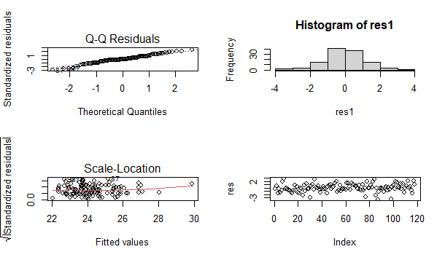
IV. REGRESSION MODEL: USING AIC METHOD
Normal distribution:
p-value = 0.08768 > 0.05
→ Residuals follow normal distribution.
Assumption 1:
p-value = 1 > 0.05
→ Mean (Residuals) = 0.
Assumption 2:
p-value = 0.6062 > 0.05
→ Variance of residuals is constant.
Assumption 3:
p-value = 0.366 > 0.05
→ There is no autocorrelation in residuals.

Slide 51
CONCLUSION

Slide 52
CONCLUSION
Vietnamese firms have made progress in adopting technology and innovation, with companies having their own websites and utilizing technology licensed from foreign-owned firms
1
However, investment in innovation and research and development has declined, leading to fewer new product launches. While manufacturing companies have been proactive in technology adoption, other sectors like retail and services are also undergoing digital transformation
2
3
The Vietnamese establishments should foster launch new products/services as well as well as having an internationally-recognized quality certification to build trust and enhance quality, which allow them to increase their total annual revenue

Slide 53
THANK YOU !

